Slide 1

Objectives
In this session, you will learn to:
  Apply conditional formatting
  Add data validation criteria
  Update a workbook’s properties
  Modify Excel’s default settings
  Protect files
  Share a workbook
  Set revision tracking
  Review tracked revisions
Notes:
Start the session by telling the students that they have learned to use Excel to perform tasks such as running calculations on data and sorting and filtering numeric data.
Now with the Excel Level 3, they will learn about some more specialized and advanced capabilities of Excel. This includes, applying advanced analysis techniques to more complex data sets, collaborating on worksheets with others, and sharing Excel data with other applications. Later share the objectives with the students.

Slide 2
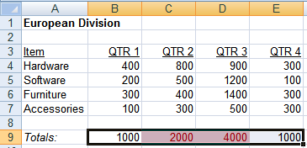
Apply Conditional Formatting
Conditional Formatting is a formatting technique that applies a specified format to a cell or range of cells.
The following figure shows conditional formatting applied to a range of cells.
Conditional format
applied to totals
that exceed 1000
Cells with Numeric Data
Notes:
Tell the students that conditionally formatting data makes it easier to quickly identify specific information that meets a given criterion. Use the figure to show an example of a worksheet with conditional formatting applied to it.

Slide 3
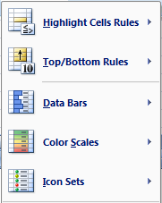
Apply Conditional Formatting (Contd.)
The following figure shows the types of conditional formats that can be applied to the worksheet.
Notes:
Refer to pages 16 and 17 to discuss about the various conditional formats. Tell the students that these formats exist under the Conditional Formatting option in the Styles group on the Home tab.

Slide 4
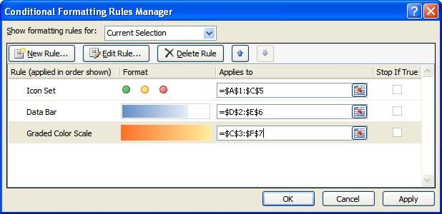
Apply Conditional Formatting (Contd.)
The Conditional Formatting Rules Manager dialog box is used to define one or more conditional format rules for data sets.
The following figure shows the Conditional Formatting Rules Manager dialog box.
Notes:
You can access the execution file for a demo on the conditional formatting from the following path in the TIRM CD and install it: TIRM\DATAFILES FOR FACULTY\LEVEL 3\Session_01\Conditional Formatting\XL2007DemoConditionalFormatting.exe

Slide 5
Demo: Creating a Conditional Format
Scenario:
  The Office Supplies Format workbook summarizes the total amount spent on office supplies in the three divisions of your company. Because of budget constraints, anyone in the Australian division who is spending more than $1,500 in a quarter needs to be notified. You want to highlight the cells that exceed the amount of $1,500 in green to draw attention to those numbers.

Slide 6
Demo: Creating a Conditional Format (Contd.)
Solution:
  To solve the preceding scenario, you need to perform the following tasks:
    Select the range displaying the totals of each quarter in the Australian worksheet tab.
    Apply a condition to the Australian quarterly totals, so that any total that exceeds $1500.00 will be formatted in green.
Notes:
Discuss the scenario of Activity 1-3 of Lesson 1 in the Student Guide with the students.
You can access the data file for this activity from the following path in the TIRM CD:
TIRM\DATAFILES FOR FACULTY\LEVEL 3\Session_03\Streamlining Workflow\Office Supplies Format.xlsx

Slide 7
Demo: Editing Conditional Formats
Scenario:
  On the Summary worksheet of the Product Sales workbook, you have applied the data bar type of conditional formatting to the Totals data. You want to make the formatting more prominent by applying a two color scale type that has orange for lower values and yellow for higher values. Also, in the B&B - Product Sales worksheet, you notice that you have applied similar conditional formatting for quarterly sales and annual sales. You do not want the Annual Totals to be formatted.

Slide 8
Demo: Editing Conditional Formats (Contd.)
Solution:
  To solve the preceding scenario, you need to perform the following tasks:
    Modify the rule for a data bar conditional format.
    Display the conditional format rule applied to the Annual Sales column in the worksheet.
    Delete the rule for the Annual Totals column.
Notes:
Discuss the scenario of Activity 1-4 of Lesson 1 in the Student Guide with the students.
You can access the data file for this activity from the following path in the TIRM CD:
TIRM\DATAFILES FOR FACULTY\LEVEL 3\Session_03\Streamlining Workflow\Product Sales.xlsx

Slide 9
Demo: Sorting and Filtering Conditionally Formatted Data
Scenario:
  On the Summary worksheet of the Product Sales workbook, you have applied the data bar type of conditional formatting to the Totals data. You want to make the formatting more prominent by applying a two color scale type that has orange for lower values and yellow for higher values. Also, in the B&B - Product Sales worksheet, you notice that you have applied similar conditional formatting for quarterly sales and annual sales. You do not want the Annual Totals to be formatted.

Slide 10
Demo: Sorting and Filtering Conditionally Formatted Data (Contd.)
Solution:
  To solve the preceding scenario, you need to perform the following tasks:
    Sort the data with high sale values on top and low sale values at the bottom.
    Filter only the data with the green font format.
Notes:
Discuss the scenario of Activity 1-5 of Lesson 1 in the Student Guide with the students.
You can access the data file for this activity from the following path in the TIRM CD:
TIRM\DATAFILES FOR FACULTY\LEVEL 3\Session_03\Streamlining Workflow\My Product Sales.xlsx

Slide 11
Add Data Validation Criteria
To force certain cells in the worksheet to accept only a specific type of data, you can add a data validation criterion.
Data validation:
  Is a technique used to restrict the value or type of data that can be given as input based on a specific set of criteria.
  Can include a user-defined input message.
  Can be applied to a cell or range of cells.
The data validation criteria helps you to improve the integrity of your data.
Notes:
You can discuss the importance of data validation by telling the following example.
The head of the Sales and Marketing department of a company states, “I need my sales managers to select a product from our company’s product line. All the pricing lookups in the worksheet rely on the product being entered correctly. I find that if I allow my managers to type an entry, they will find too many ways to misspell items. For example, where I may be expecting PDT-960, they are likely to enter PDT 960, 960, and many other variations. Therefore, the worksheet needs to validate the data entered by the sales managers”.
In the preceding example, tell that the sales managers can automatically select the correct spelling of the product from a list that has been set to the desired criteria by using the Data Validation command. The Data Validation command restricts every cell entry by validating the entered value with the value being set.

Slide 12
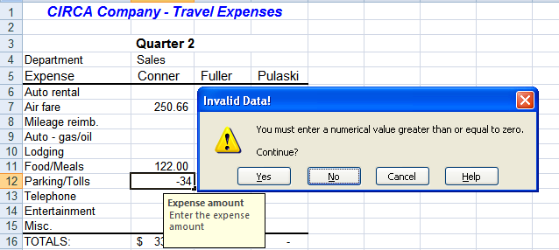
Add Data Validation Criteria (Contd.)
The following figure shows the data validation technique applied to a range of cells.
Error message
that appears when
invalid data is input
Range of cells that
accepts values
greater than or
equal to zero
Invalid Data
User-Defined
Input Message
Notes:
Addition Input:
You can use the following link to provide additional inputs on types of data that can be validated, types of messages that can be displayed, setting up data validation.
http://office.microsoft.com/en-us/excel/HA010346571033.aspx

Slide 13
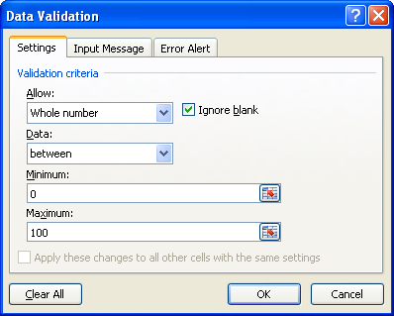
Add Data Validation Criteria (Contd.)
Data Validation dialog box has three tabs to specify the settings, input message, and error alert for data that can be entered in a cell.
The following figure shows the three tabs of the Data Validation dialog box.

Slide 14
Demo: Adding Data Validation Rules
Scenario:
  You are creating a workbook that tracks monthly travel expenses for employees. In order to ensure that the data in the workbook remains valid, you decide to impose the following restrictions to the data in the range of cells that store the expense values:
    Force any cell in the range to accept only numerical values less than 10000.
    Label each cell in the range with a short note explaining the type of data the cells can store.
    Return an error message if a user tries to enter a nonnumeric value into any cell in the range.
    Allow the user to select a valid entry from a drop-down list.
    Restrict the destination name entered to six letters.

Slide 15
Demo: Adding Data Validation Rules (Contd.)
Solution:
  To solve the preceding scenario, you need to perform the following tasks:
    Set the validation criteria to accept decimal values less than 10000 for the range B7:D16.
    Set a message that will display on any cell of the selected range.
    Set the error alert for invalid data.
    Create a drop-down list for entering a valid department name.
    Create a data validation rule that restricts the length of characters allowed in a cell to six.
    Test the data validation rules.
Notes:
Discuss the scenario of Activity 1-6 of Lesson 1 in the Student Guide with the students.
You can access the data file for this activity from the following path in the TIRM CD:
TIRM\DATAFILES FOR FACULTY\LEVEL 3\Session_03\Streamlining Workflow\Monthly Expenses.xlsx

Slide 16
Update a Workbook’s Properties
You can identify a workbook with specific information, such as a title and summary, that enables you to easily locate the workbook.
To attach specific information to a workbook which makes it easier to locate the file on a computer, you can update the workbook properties.
The document Information panel is used to specify information that helps to identify or describe the workbook:
  When you select Advanced Properties from the Document Properties drop-down list, the [Document Name] Properties dialog box is displayed:
    This dialog box consists of five tabs of information regarding the opened file.
Notes:
Help students recollect the file types associated with Excel 2007 by using the following input.
xlsx: This file extension signifies an Excel 2007 workbook file. Earlier versions of Excel used the xls extension.
xlsm: This Excel 2007 file extension signifies a macro enabled workbook.
xltx: This Excel 2007 file extension signifies an Excel 2007 template file. Earlier version used xlt extension.
xltm: This Excel 2007 file extension indicates that the file is a macro enabled Excel 2007 template file.
xlsb: This Excel 2007 file extension signifies an Excel binary workbook.
xlam: This Excel 2007 file extension signifies an Excel add-in. An add-in is a type of program that adds extra features or functionality to Excel.

Slide 17
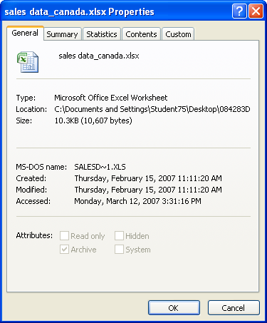
Update a Workbook’s Properties (Contd.)
The following figure shows the Properties dialog box.

Slide 18
Demo: Updating a Workbook’s Properties
Scenario:
  Josh Duvane recently began developing a workbook titled Sales Data Canada. However, Josh was recently reassigned to a new group in your company and was unable to finish development on the workbook. His manager, Roberta Williams, wants to identify the file as “Sales Data – Canada.” She also wants her name listed as the manager of the file, Josh’s name as the author of the file, and Mary Coleman’s name listed as the editor of the file. Additionally, she would like to be able to easily locate the file using words like “Canada,” “Sales,” and “Vendor Code.”

Slide 19
Demo: Updating a Workbook’s Properties (Contd.)
Solution:
  To solve the preceding scenario, you need to perform the following tasks:
    Add a title to the workbook.
    Add the author name, manager name, and keywords to the file.
    Add a custom property noting Mary Coleman as the editor of the file.
    View the properties of the updated file without opening it.
Notes:
Discuss the scenario of Activity 1-7 of Lesson 1 in the Student Guide with the students.
You can access the data file for this activity from the following path in the TIRM CD:
TIRM\DATAFILES FOR FACULTY\LEVEL 3\Session_03\Streamlining Workflow\Sales Data Canada.xlsx

Slide 20
Modify Excel’s Default Settings
To make all the new files automatically start with the settings defined by you, it is required to change the Excel’s default settings.
  This helps to streamline your workflow by forcing Excel to use settings you have defined to meet your current business needs.

Slide 21
Demo: Modifying Excel’s Default Settings
Scenario:
  You are in the process of setting up your Excel environment for a new project. You know that every workbook you create for this project will have a minimum of five worksheets and that all of the text for each workbook must appear in size 12 point with Courier New font. Because you want to keep the files for this project separate from other Excel files on your computer, you have decided to create a new folder named My Project Files in the My Documents folder.

Slide 22
Demo: Modifying Excel’s Default Settings (Contd.)
Solution:
  To solve the preceding scenario, you need to perform the following tasks:
    Set the default number of sheets in a new workbook to five.
    Set the default font style and size to Courier New and 12, respectively.
    Create a new folder called My Project Files in the My Documents folder.
    Change the default location to save the Excel workbooks to the My Project Files folder in My Documents.
    Test your work.
Notes:
There are no files to open.

Slide 23
Protect Files
You should protect Excel files before you share with others.
By protecting files you have the flexibility to share the files knowing that the data is secure.
The collaboration process to share Excel workbooks with other users involves four stages:
  Protecting
  Saving
  Sharing
  Reviewing

Slide 24
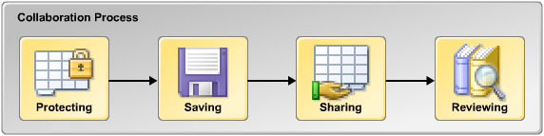
Protect Files (Contd.)
The following figure shows the various stages in the collaboration process.

Slide 25
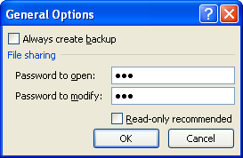
Protect Files (Contd.)
File protection options:
  You can authorize opening of a workbook and authorize modification of a workbook.
  You can protect the worksheet structure and window layout of workbooks from other users by setting a password.
The following figure shows the file protection options in the General Options dialog box.
Password to prevent
unauthorized opening
of workbook
Password to prevent
unauthorized modification
of workbook
Notes:
You can use the following link for more information on protection options of an Excel file.
http://www.uwec.edu/help/Excel07/ws-protect.htm

Slide 26

Protect Files (Contd.)
To protect, share, edit, and track changes in a worksheet or a workbook, you can use the options of the Changes group on the Review tab of the Ribbon.
The following figure shows the options of the Changes group.
Notes:
Additional Input:
You can use the following link for more information on locking and unlocking of cell in Excel 2007 worksheet.
http://www.uwec.edu/help/Excel07/ws-protect.htm

Slide 27
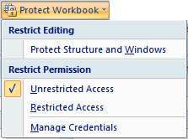
Protect Files (Contd.)
To restrict permission to edit and access a workbook, you can use the Protect Workbook option in the Changes group of the Review tab.
The following figure shows the options of the Changes group.
Notes:
For more information on use of workbook protection the following link.
http://office.microsoft.com/en-us/products/FX101153381033.aspx

Slide 28
Demo: Protecting a Worksheet
Scenario:
  The Display workbook contains a worksheet you want to give to other users. You have decided to allow anyone to open the file, select a cell or range of cells, and make formatting changes to the worksheet, but only someone with the worksheet’s password can make changes to the numerical values stored in the worksheet.

Slide 29
Demo: Protecting a Worksheet (Contd.)
Solution:
  To solve the preceding scenario, you need to perform the following tasks:
    Lock the contents in the worksheet and hide the formulas.
    Password protect the worksheet allowing only the selection of locked cells, unlocked cells, and formatting of cells.
    Test your work.
    Check whether users with the password can edit the worksheet.
Notes:
Discuss the scenario of Activity 2-1 of Lesson 2 in the Student Guide with the students.
You can access the data file for this activity from the following path in the TIRM CD:
TIRM\DATAFILES FOR FACULTY\LEVEL 3\Session_03\Collaborating with Others\Display.xlsx

Slide 30
Demo: Allowing Users to Edit a Specified Range
Scenario:
  You have given your protected copy of display.xlsx to others. Some users would like to edit only the range of cells in the Bonus Table. You want to enable users to unlock the Bonus Table range with a password. The password for this range will differ from the password that allows users to unprotect the worksheet. Also, you want to check for any comments in the workbook and delete them in order to avoid confusion, as they are no longer valid.

Slide 31
Demo: Allowing Users to Edit a Specified Range (Contd.)
Solution:
  To solve the preceding scenario, you need to perform the following tasks:
    Inspect the document for comments and remove them.
    Define the entire range of cells in the Bonus Table as editable.
    Assign a password to the range and then apply the protection.
    Protect the worksheet.
    Test your work.
Notes:
Discuss the scenario of Activity 2-2 of Lesson 2 in the Student Guide with the students.
You can access the data file for this activity from the following path in the TIRM CD:
TIRM\DATAFILES FOR FACULTY\LEVEL 3\Session_03\Collaborating with Others\My Display.xlsx

Slide 32
Demo: Protecting a Workbook
Scenario:
  You have completed work on the Regional Sales workbook. Now you want to let others contribute to the workbook, but you don’t want anyone to rearrange the worksheets or move the windows in the file. You also want to ensure that only users with the password can open the workbook.

Slide 33
Demo: Protecting a Workbook (Contd.)
Solution:
  To solve the preceding scenario, you need to perform the following tasks:
    Password-protect the workbook’s structure and windows.
    Try to modify the structure and window layout of the workbook.
    Save the workbook with a password.
    Test the password-protected workbook.
Notes:
Discuss the scenario of Activity 2-3 of Lesson 2 in the Student Guide with the students.
You can access the data file for this activity from the following path in the TIRM CD:
TIRM\DATAFILES FOR FACULTY\LEVEL 3\Session_03\Collaborating with Others\Regional Sales.xlsx

Slide 34
Share a Workbook
It is easy to create a single workbook that many people can access, manipulate, and respond to by sharing it with others.
The SharePoint Server:
  Is a collaboration and content management server.
  Is integrated with the Office 2007 suite.
  Acts as a repository of documents where files can be saved and accessed from different locations.
  Tracks the work done on a file by maintaining information on users and file versions.
  Acts as a common platform for hosting content from the Internet and an intranet.
  Can be used to control access and content modification permissions for files stored on the server.
Notes:
Explain the need to share a workbook by using the introduction provided in the following link.
http://www.lockergnome.com/windows/2007/06/07/share-a-workbook-in-excel-2007/

Slide 35
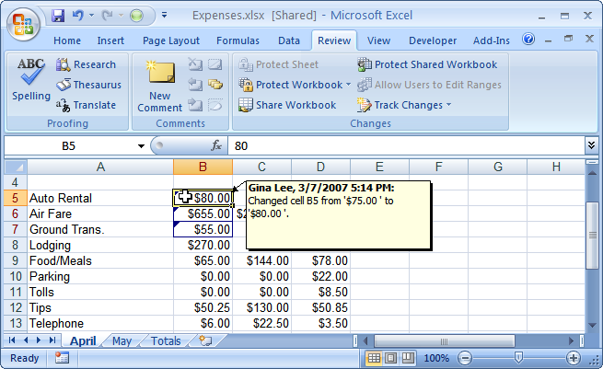
Share a Workbook (Contd.)
Shared workbook is set up and saved to allow multiple users to view, edit, and save the same workbook at the same time.
The following figure shows a shared workbook.
Text indicating that the
workbook is shared
Change made by a
different user
can be viewed
All changes
highlighted
during review
Notes:
Tell the students that an Excel 2007 workbook can be shared by using Excel Services or Document Management Services. For more information use the ‘New ways to share your work’ part from the following link.
http://office.microsoft.com/en-us/help/HA100738731033.aspx

Slide 36
Discovery Demo: Creating a Shared Workbook
Scenario:
  You are the human resources manager at your company.
  You need to share the phonelist file that contains the name, department, office, and phone extension information for employees. This is an informal list that each department manager will need to update periodically. Because each manager will need access to the file, you have decided to share the workbook and save it in a designated location on
  the network. You need to keep track of the changes made to the workbook in the last 15 days. You also realize that you need to add some more details of Jaco Prestia—a new
  human resources employee—to the Gwillis list that resides
  on the server. Jaco is in office 9f and his phone extension is 2699.
Notes:
The solution is provided as a simulation in the TIRM CD.
Discuss the scenario of Activity 2-4 of Lesson 2 in the Student Guide with the students.
You can access the simulation for this activity from the following path in the TIRM CD:
TIRM\DATAFILES FOR FACULTY\LEVEL 3\Session_03\Collaborating with Others\Simulations\Create Shared Workbook_guided.exe

Slide 37
Set Revision Tracking
To set tracking options in order to track any changes made to a given worksheet or workbook, you can set revision tracking.
Revision tracking:
  Is a formatting technique used to track any change made to a workbook.
  Tracks details such as:
    The person who made the change.
    The date and time when the change was made.
    Where in the workbook the change was made.
Notes:
Start by telling the students that by default, when you make changes to a file with the Track Changes feature turned on, your user name and/or initials are stored in the workbook and associated with the changes that you make. This information, including both the original and revised text, is then available to anyone who has access to your file.

Slide 38
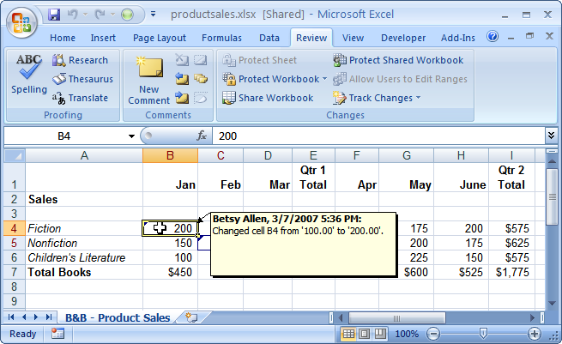
Set Revision Tracking (Contd.)
The following figure shows a workbook set to Revision Tracking mode.
Workbook set to Revision
Tracking mode becomes shared
Revision Tracking tracks
the person, date, and the
time of the change made

Slide 39
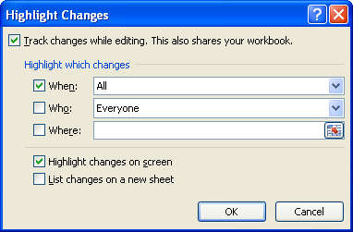
Set Revision Tracking (Contd.)
The Highlight Changes dialog box:
  Is used to set highlighting options for revision tracking.
  Allows the user to enable track changing in the workbook.
The following figure shows the Highlight Changes dialog box.

Slide 40
Demo: Setting Revision Tracking
Scenario:
  You have entered the necessary details into the Product Sales_01 workbook. Another person in your organization will need to add more music genres to the CDs And Tapes section of the workbook. You need to set the options in order to track every change made to the file so that you can validate the new data.
  You have one more workbook that has to be sent to the Sales Manager for review. You decide to enable the option for viewing the changes made by the Manager so that you can later accept or reject them.

Slide 41
Demo: Setting Revision Tracking (Contd.)
Solution:
  To solve the preceding scenario, you need to perform the following tasks:
    Turn on revision tracking in the Product Sales_01 workbook using the Track Changes command.
    Test your work.
    Set review tracking in Product Sales_02 using the Protect And Share Workbook command.
Notes:
Discuss the scenario of Activity 2-2 of Lesson 2 in the Student Guide with the students.
You can access the data files for this activity from the following path in the TIRM CD:
TIRM\DATAFILES FOR FACULTY\LEVEL 3\Session_03\Collaborating with Others\Product Sales_01.xlsx
TIRM\DATAFILES FOR FACULTY\LEVEL 3\Session_03\Collaborating with Others\Product Sales_02.xlsx

Slide 42
Review Tracked Revisions
To see what changes have been made to the file, and to accept or reject them as required, you can review tracked revisions.
You can make sure that any revisions made to a file are correct before the core content of the file is changed, by reviewing tracked revisions.

Slide 43
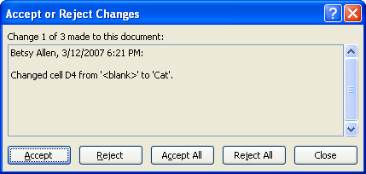
Review Tracked Revisions (Contd.)
The Accept/Reject Changes option allows you to decide which changes you want to retain and which to discard after a tracked review.
The following figure shows the Accept or Reject Changes option.

Slide 44
Demo: Accepting and Rejecting Tracked Changes
Scenario:
  You just received the product sales workbook back, and you are ready to review the changes made to the file. The details for the Hip-hop music sales have been modified. You need to list the changes on a new worksheet, highlight the changes on-screen, and accept or reject them as needed.

Slide 45
Demo: Accepting and Rejecting Tracked Changes (Contd.)
Solution:
  To solve the preceding scenario, you need to perform the following tasks:
    Highlight the changes made by Esme, and list the changes on a new worksheet.
    Accept the changes in the B&B - Product Sales worksheet.
Notes:
Discuss the scenario of Activity 2-2 of Lesson 2 in the Student Guide with the students.
You can access the data file for this activity from the following path in the TIRM CD:
TIRM\DATAFILES FOR FACULTY\LEVEL 3\Session_03\Collaborating with Others\Reviewed Product Sales.xlsx

Slide 46
Summary
In this session, you learned that:
  The Conditional Formatting Rules Manager dialog box is used to define one or more conditional format rules for data sets.
  To force certain cells in the worksheet to accept only a specific type of data, you can add a data validation criterion.
  The document Information panel is used to specify information that helps to identify or describe the workbook.
  To protect, share, edit, and track changes in a worksheet or a workbook, you can use the options of the Changes group on the Review tab of the Ribbon. The SharePoint Server is a collaboration and content management server that acts as a repository of documents where files can be saved and accessed from different locations.
Notes:
Use the Summary slides to summarize the session.

Slide 47
Summary (Contd.)
  Revision tracking is a formatting technique used to track any change made to a workbook.
  The Accept/Reject Changes option allows you to decide which changes you want to retain and which to discard after a tracked review.
Notes:
Use the Summary slides to summarize the session.

